Slide 1


Santa Ana Unified School District
2024-2025 Adopted Budget Report
BOARD PRIORITY: Organizational Efficiency & Effectiveness
June 11, 2024

Slide 2
Budget Timeline
Notes:
As we often point out, the Budget team is always working on multiple fiscal years at any given time.
This slide shows the full budget cycle for the current year, as well as the budget development timeline for the 2024-2025 year.
Pause

Slide 3
Budget Timeline
Notes:
…which brings us to the second interim report tonight.
Based on actuals through January 31.
Seven complete months in the fiscal year, and six operational months since the beginning of the school year.
This gives us much better insight into the expenditure patterns year-to-date than we had at first interim, and allows us to fine-tune the projections for the balance of the year.

Slide 4
Ending Fund Balance
← Actuals
Projections →
Notes:
As we have done for previous reports, we are starting tonight with the projected multiyear ending fund balance.
I do want to point out now that the projected deficit spending in 2024-2025 and 2025-2026 (the out years) is more steep than it was at first interim.
As we go through the slides, we will discuss how we arrived at these projections.

Slide 5
Ending Fund Balance
Notes:
As we have done for previous reports, we are starting tonight with the projected multiyear ending fund balance.
I do want to point out now that the projected deficit spending in 2024-2025 and 2025-2026 (the out years) is more steep than it was at first interim.
As we go through the slides, we will discuss how we arrived at these projections.

Slide 6
Official Assumptions
Official Assumptions
2023-2024
2024-2025
2025-2026
2026-2027
Cost of Living Adjustment (COLA)
8.22%
1.07%
2.93%
3.08%
Enrollment (excludes ALA)
37,663
35,978
34,394
32,760
Change in Enrollment
-1,685
-1,584
-1,634
Average Daily Attendance (ADA)
35,195
34,233
33,070
31,646
Funded ADA
40,128
37,332
35,442
34,293
Unduplicated Pupil Percentage (UPP)--CY
87.61%
89.45%
91.44%
92.88%
UPP (3 year average)
83.86%
86.69%
89.44%
91.20%
Certificated Step & Column
0.75%
0.75%
Classified Step & Column
0.25%
0.25%
STRS Rate
19.10%
19.10%
19.10%
19.10%
PERS Rate
26.68%
27.05%
27.60%
28.00%
COLA
  Incremental increases in percentages since second interim
ADA
  Increases in UPP and attendance factor
PERS
  Incremental decreases since second interim
Notes:
Here are some of the official assumptions for the second interim report.
COLA for 2024-2025 .76% versus the 3.94% The 2025-2026 COLA has also been reduced; we are at 2.76% versus the 3.29% at first interim.
increased enrollment projection out years to reflect the projections by Davis Demographic
2024 -2025 increased by 244 to 35978; and 2025-2026 increased by 507 to 33,070
That does not mean… It is still significant; we are losing 4 1/2% of our students between the current year and 2024-2025; and 4.4% between 2024-2025 and 2025-2026.
For ADA, hard look at attendance patterns, seen some increases CY. assumed increases in both of the out years The AF in CY is 94.2%, for 2024-2025 95.1%, in 2025-2026, 96.2%
I will come back to Funded ADA in future slides.
UPP
There are also incremental increases in the PERS rates in the out years. The rate for 2024-2025 increased by .1% from 27.7% to 27.8%…and the rate for 2025-2026 increased by .2% from 28.3% to 28.5%

Slide 7
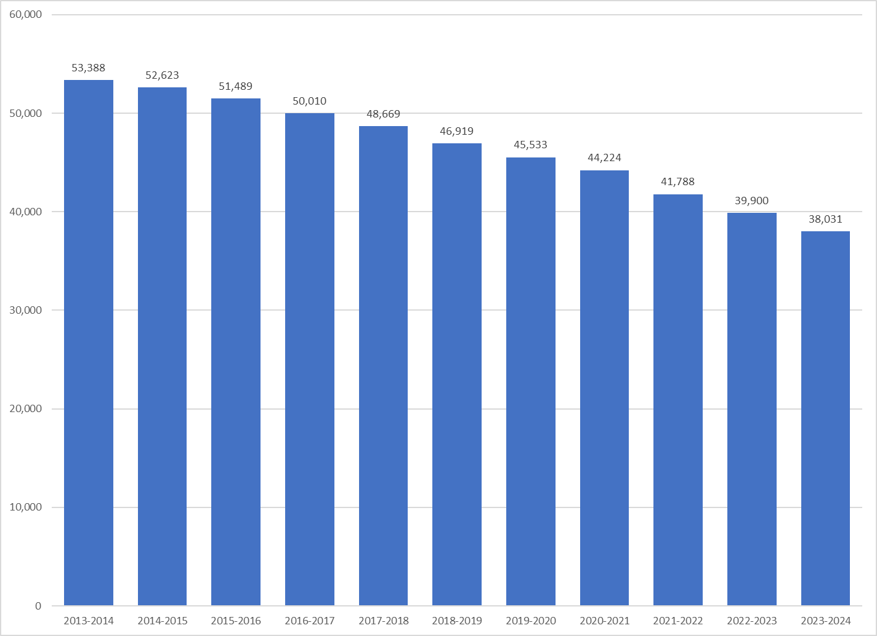
Source: CDE DataQuest
Includes ALA
Enrollment,
ADA, and Funded ADA
Notes:
Here is a quick look at our overall enrollment since 2013-2014; since that time we have lost almost 29% of our students. That is sobering, and we do need to stay focused on this,
However, from a funding standpoint, we are fortunate to have a hold harmless provision in place on ADA, and I want to spend some time going over the relationship between enrollment, ADA, and funded ADA..

Slide 8
Enrollment,
ADA, and Funded ADA
Notes:
This slide shows the historical trends on enrollment, ADA, and Funded ADA
The purple line in the middle is enrollment…CBEDS info day, October. The red line on the bottom is average daily attendance, which is the average number of students actually in attendance from the first day of school to the end of the P2 attendance period, which is legally defined as the last school month ending on or before April 15 of a school year. For this school year, the P2 period ends on March 29.
Funded ADA is currently defined by statute as the greater of current year ADA or the average of the three prior years of ADA. We call this the hold harmless provision
This is incredibly helpful for a District like Santa Ana that is experiencing severe declines in enrollment; and our financial situation would be much worse if not for the ADA hold harmless.
This slide has a lot of numbers on it, so lets take a look at some simplified slides that show how the HH works.

Slide 9
Revenue
Variances
LCFF
  Declining Enrollment
Federal
  Deferred Revenue
Other State
  Equity Multiplier, Pathway Grants
  SPED, Lottery
Other Local
  Interest
  Medi-Cal billing
Notes:
Here is the current year revenue.
For each of these slides, we will show what the approved budget was at the time of unaudited actuals, back in September

Slide 10
Revenue
←Actuals
Projections→

Slide 11
Revenue
2024-2025 Revenue
2024-2025 Revenue
Adopted Budget
Notes:
Here is graphical rep of all revenue sources
Green and Purple still bigger due to COVID Relief
But LCFF still makes up the lion’s share of our revenue
Which makes…

Slide 12
LCFF Revenue
Notes:
…this slide very important.

Slide 13
Salaries & Benefits
Variances
Certificated
  Potential increase
  Reductions--attrition
Classified
  Salary Increases
  Filled vacancies

Slide 14
Salaries & Benefits
← Actuals
Projections→
Notes:
Pause:
Trendline

Slide 15
Supplies, Services, & Capital Outlay
Variances
Supplies
  ELOP
Services
  Insurance
Capital Outlay
  GF Facilities Projects
    Erate
    HVAC

Slide 16
Supplies, Services, & Capital Outlay
← Actuals
Projections→

Slide 17
Expenditures
Salaries & benefits account for 81% of
District expenditures ($778M of the $961M)

Slide 18
Total Revenue & Expenditures
Variances--Revenue
LCFF
  Declining Enrollment
Federal
  Deferred Revenue
Other State
  Equity Multiplier, Pathway Grants
  SPED, Lottery
Other Local
  Interest
  Medi-Cal billing
Variances--Expenditures
Supplies
  ELOP
Services
  Insurance
Capital Outlay
  GF Facilities Projects
    Erate
    HVAC

Slide 19
Total Revenue & Expenditures
← Actuals
Projections→

Slide 20
Ending Fund Balance
← Actuals
Projections→
Notes:
361.3 vs 375.8 M
264.2 vs 298.5 M
181.5 vs 264.2 M

Slide 21
Ending Fund Balance
Notes:
counterclockwise

Slide 22
Next Steps
Final Budget Negotiations
Unaudited Actuals
Continued Budget Discussions

Slide 23
Budget Timeline
Notes:
…which brings us to the second interim report tonight.
Based on actuals through January 31.
Seven complete months in the fiscal year, and six operational months since the beginning of the school year.
This gives us much better insight into the expenditure patterns year-to-date than we had at first interim, and allows us to fine-tune the projections for the balance of the year.

Slide 24
Budget Discussions

Slide 25

Thank you!
Questions?

